Slide 2
* WARM-UP
Villa
Types of house
Villa, apartment, flat, country house, town house, building, stilt house, rong house, cottage, farmhouse, tree house, houseboat, detached house,…

Slide 3
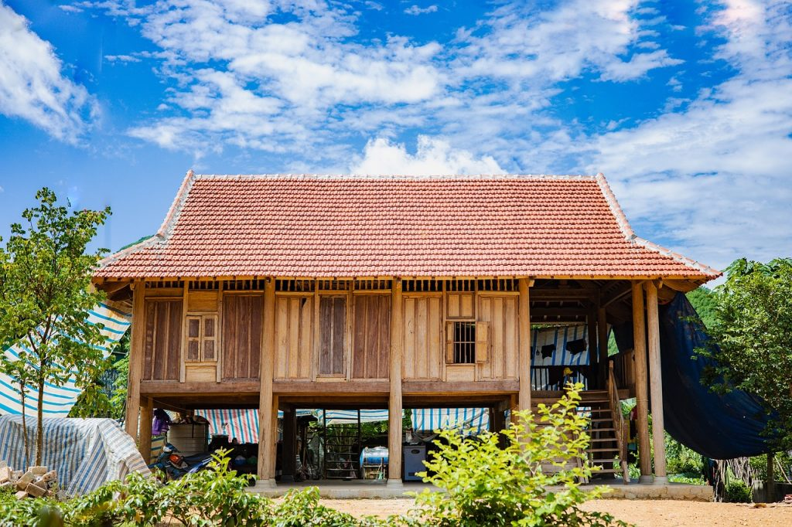
Unit
4
ETHNIC GROUPS OF VIET NAM
Unit
ETHNIC GROUPS OF VIET NAM
LESSON 5: SKILLS 1
LESSON 3: A CLOSER LOOK 2
HOBBIES

Slide 4
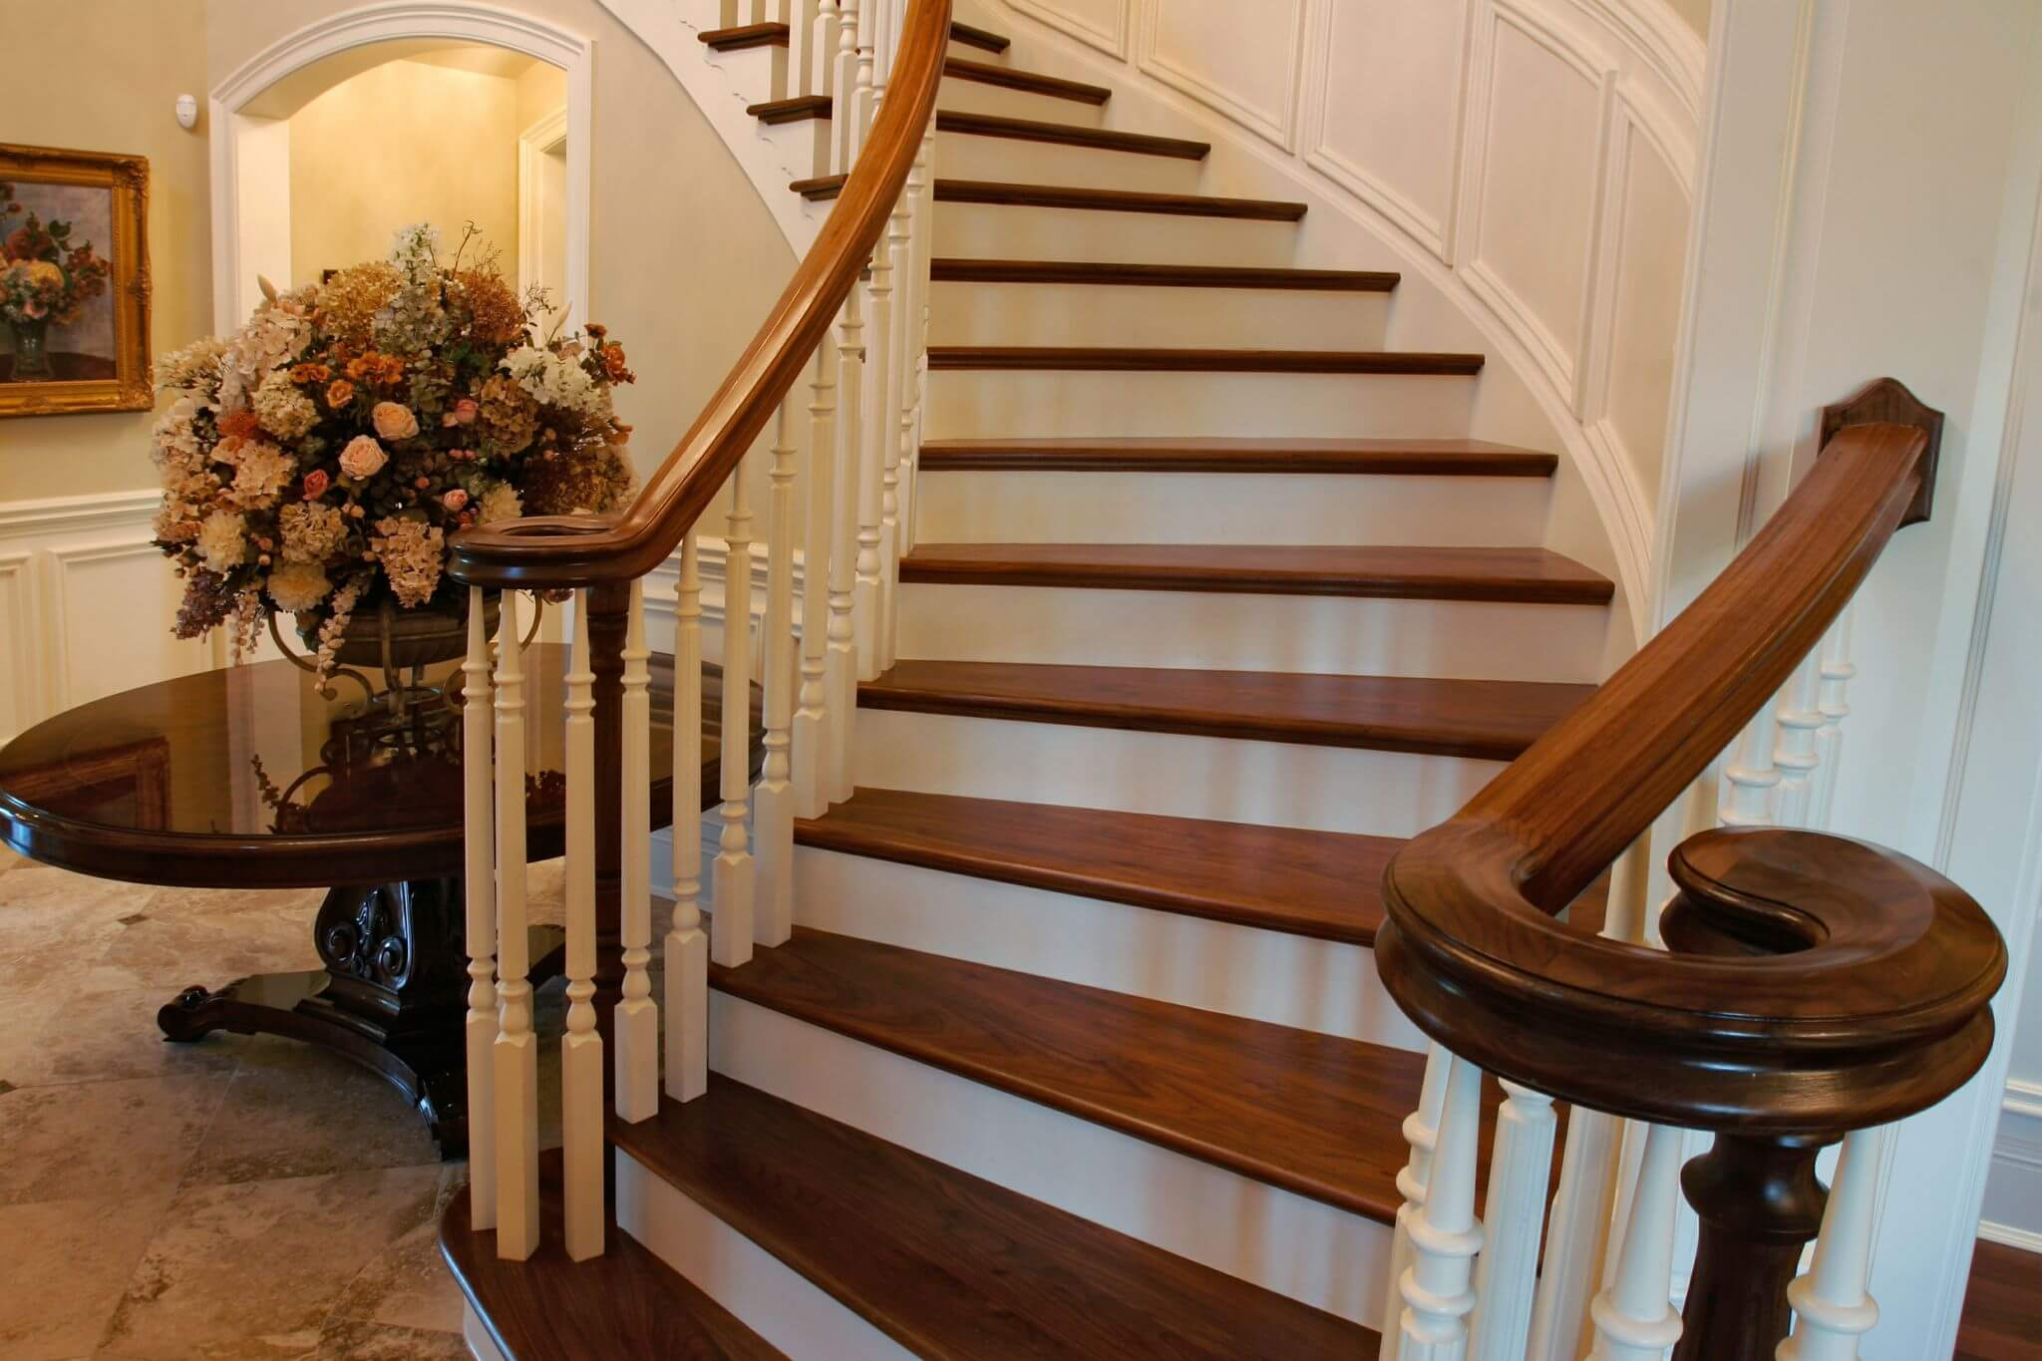
* VOCABULARY
- staircase (n):
cầu thang bộ
/ˈsteəkeɪs/

Slide 5
* VOCABULARY
- material (n):
vật liệu
/məˈtɪəriəl/

Slide 6
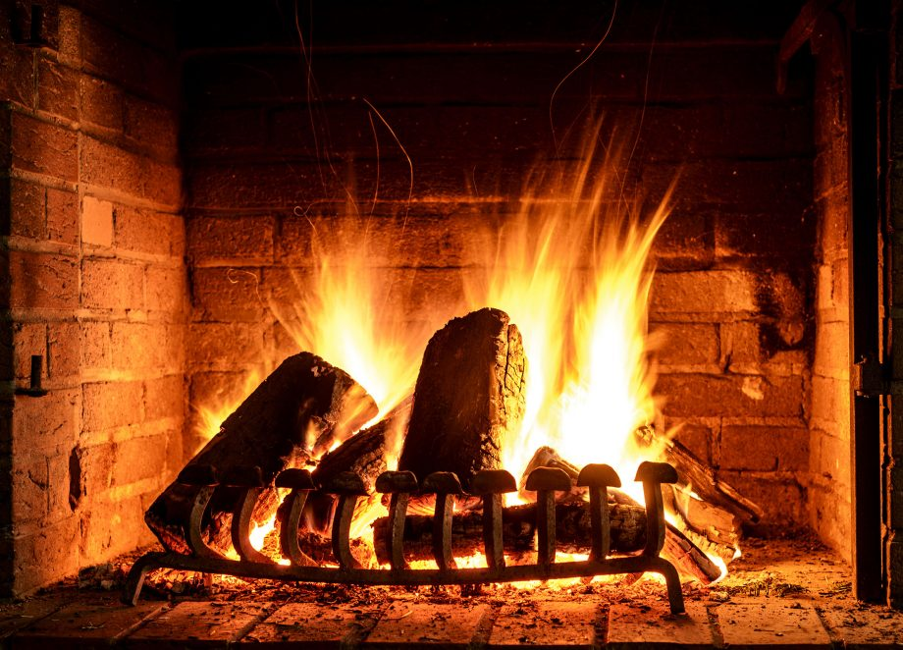
VOCABULARY
* VOCABULARY
open fire (n):
lò sưởi
/ˌəʊpən ˈfaɪə/

Slide 7
* VOCABULARY
- owner (n):
người sở hữu
/ˈoʊnə/

Slide 8
* VOCABULARY
New words | Pronunciation | Meaning
1. staircase (n) | /ˈsteəkeɪs/ | cầu thang bộ
2. material (n) | /məˈtɪəriəl/ | vật liệu
3. open fire (n) | /ˌəʊpən ˈfaɪə/ | lò sưởi
4. owner (n) | /ˈoʊnə/ | người sở hữu

Slide 9
* Checking vocabulary
New words |  | Meaning
1. staircase (n)
2. material (n)
3. open fire (n)
4. owner (n)
vật liệu
người sở hữu
cầu thang bộ
lò sưởi

Slide 10
I/ READING
1
Write the words and phrase from the box under the correct pictures.
open fire
posts
staircase
1. _______________
2. _______________
3. _______________

Slide 11
2
Read the passage and tick T (True) or F (False)
Stilt houses
Stilt houses are popular among different ethnic minority groups, from the Thai in the Northern Highlands to the Khmer in the Mekong Delta. The houses come in different sizes and styles, and show the traditional culture of their owners.
Stilt houses are made from natural materials like wood, bamboo, and leaves. They stand on strong posts, about two or three metres above the ground. This allows them to keep people safe from wild animals. People climb a seven- or nine-step staircase to enter the house. The most important place in the house is the kitchen. It has an open fire in the middle of the house. It is the place for family gatherings and receiving guests.
The stilt houses of the Tay and Nung usually overlook a field. The stilt houses of the Thai, however, face mountains or a forest. The Bahnar and Ede have a communal house (called a Rong house) as the heart of their village. These communal houses are the largest and tallest ones in the village.

Slide 12
2
Read the passage and tick T (True) or F (False)
Statements | True | False
1. Only a few minority groups live in stilt houses.
2. All stilt houses look alike.
3. Family gatherings take place by the open fire in the middle of the house.
4. The Rong house serves as the centre of an Ede village
The most important place in the house is the kitchen. It has an open fire in the middle of the house. It is the place for family gatherings and receiving guests
The Bahnar and Ede have a communal house (called a Rong house) as the heart of their village.
The houses come in different sizes and styles, and show the traditional culture of their owners.
Stilt houses are popular among different ethnic minority groups, from the Thai in the Northern Highlands to the Khmer in the Mekong Delta.

Slide 13
3
Read the passage again and fill in each blank with one word.
1. A stilt house shows the _________ culture of the owner.
2. The Tay’s and Nung’s stilt houses overlook a _________.
3. The Thai’s stilt houses overlook a _________ or __________.
4. The largest and tallest house in an Ede village is the _________ house.

Slide 14
LUCKY NUMBER!
1
2
3
4
6
7
A
2
4
6
8
10
12
14
B
2
4
6
8
10
12
14

Slide 15
3
Read the passage again and fill in each blank with one word.
1. A stilt house shows the _________ culture of the owner.
traditional

Slide 16
3
Read the passage again and fill in each blank with one word.
2. The Tay’s and Nung’s stilt houses overlook a _________.
field

Slide 17
3
Read the passage again and fill in each blank with one word.
3. The Thai’s stilt houses overlook a _________ or __________.
forest
mountains

Slide 18
3
Read the passage again and fill in each blank with one word.
4. The largest and tallest house in an Ede village is the _________ house.
Rong

Slide 19
LUCKY NUMBER!
you get 2 plus points

Slide 20
LUCKY NUMBER!
you get 2 plus points

Slide 21
3
Read the passage again and fill in each blank with one word.
1. A stilt house shows the _________ culture of the owner.
traditional
2. The Tay’s and Nung’s stilt houses overlook a _________.
field
3. The Thai’s stilt houses overlook a _________ or __________.
forest
mountains
4. The largest and tallest house in an Ede village is the _________ house.
Rong

Slide 22
II/ SPEAKING
4
Work in pairs. Discuss and tick ( )the features of a stilt house from the list below. Share your opinions with the class.
A stilt house ____________.
- has a flat cement roof
- stands on big posts
- is made from natural materials
- has a modern toilet
- is a flat in a big block
- is close to nature

Slide 23
5
Work in pairs. Ask and answer about the type of home each of you lives in. Take notes of your partner’s answer and report what you find to the class.
1. What type of home do you live in?
2. What materials is it made from?
3. What is the most important part of your home? What do you do there?

Slide 24
* CONSOLIDATION
In this lesson, you have:
learnt new words related to the topic of stilt house.
read a passage about stilt houses.
described the house you live in.

Slide 25
* Homework
Learn by heart all the words.
Do exercises in the workbook.
Prepare for Lesson 6 – Skills 2.

Slide 26
Thanks for your atendance!
Goodbye. See you again
Notes:
26

